Slide 1
Vending Machine
EEE-301/302 Final Project
By Group-11

Slide 2

Project Statement/Research
Everyday products are marked up in price due to high overhead costs,(labour,electricity and space) and are not available round the clock. Our vending machine will aim to tackle these problems.

Slide 3
Objective
A vending machine core objective is to store dried food,beverages and everyday products and dispense them once the appropriate amount of money has been inserted. It also needs to give back changes if the
amount of money is more than the price of the product or give the back the entire sum of money if it is insufficient.
We will try to implement the following features in the vending machine we are designing:
Vend products at 3 different price points
Accept 2 kinds of coins/notes
If the amount of money inserted is more than the price of the product, the vending machine will give change back.
Displaying the amount of money inputted
Display change to be given
Self-starting with the initial coin
Will display using LED if purchase is successful (Green) or unsuccessful (RED).
If insufficient money is inserted then vending machine will return the money inserted as change.

Slide 4

Motivation
Vending machines are a one-time investment. They require no staff, which means no extra wages to pay.
In a crowded place like dhaka city vending machine is the perfect investment for saving up spaces.
Most importantly using vending machine during this pandemic situation can reduce the spread of covid-19 virus by reducing human interaction.

Slide 5
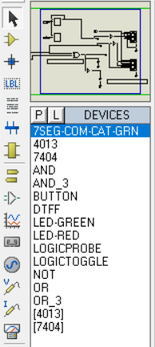
Equipment List
7 Segment Common Cathode Display
Dual D-Type Flip flop (with Set and Reset)
Inverter
Two Input and Three input AND Gate
Two Input and Three input OR Gate
Green and Red LED
Logic Probe
Logic Toggle
D-Clock
Button
[All of these Equipments were picked from the library of PROTEUS 7.7 Professional Portable.
Some equipments were taken of different variety. ]

Slide 6
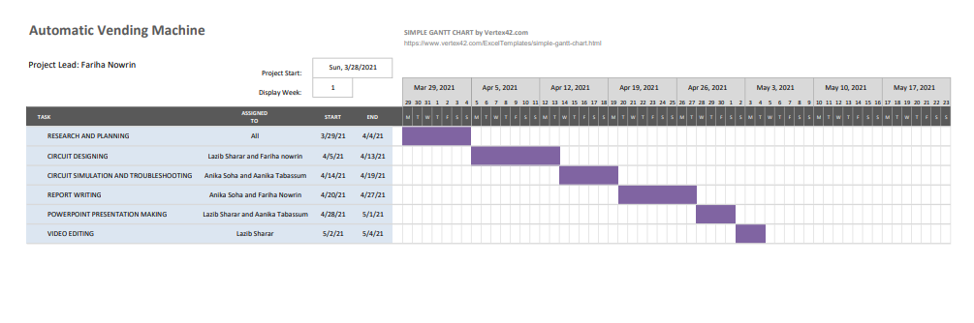
Gantt Chart

Slide 7
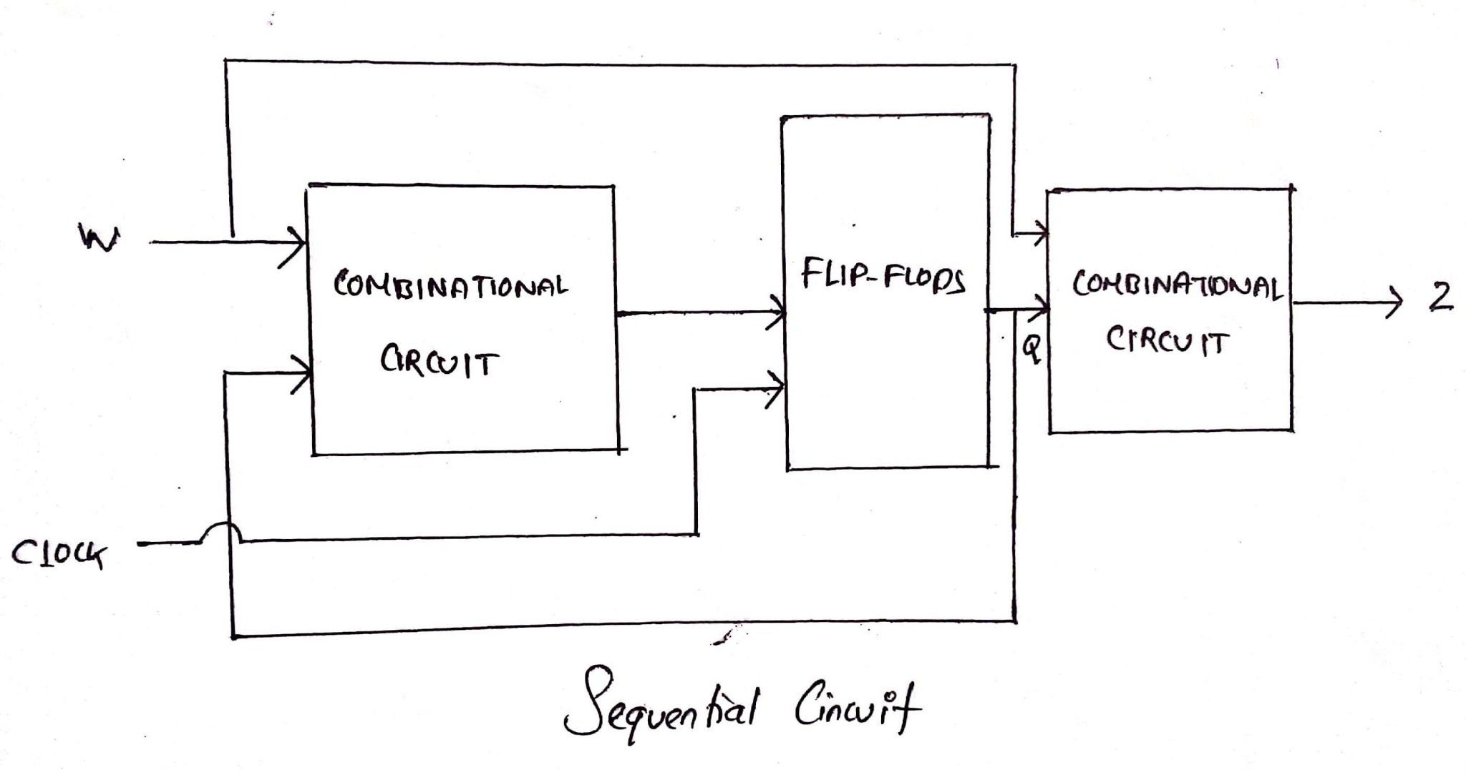
Methodology/Theory/Calculations
Price Points: 5tk, 10tk, and 15tk
Money to be accepted: 5tk and 10tk
State assigned:
So = 00 0tk = 00
S1 = 01 5tk = 01
S2 = 10 10tk = 10
X = 11 X = 11
-legend:
0/0/0 money in/purchase/change

Slide 8
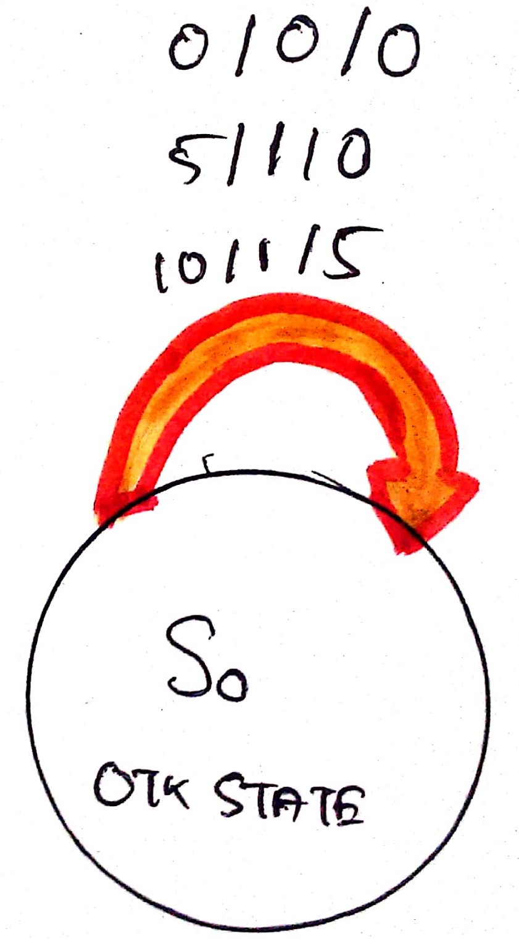
State Flow Diagram for 5tk price point

Slide 9
Methodology for for 5TK PRICE POINT
State Assigned Table:
Present state (y2y1) | Next State (Y2Y1) (w2w1) | Output
Z (w2w1) | C2C1 (w2w1)
 | 00 | 01 | 10 | 11 | 00 | 01 | 10 | 11 | 00 | 01 | 10 | 11
00 | 00 | 00 | 00 | x | 0 | 1 | 1 | x | 00 | 00 | 01 | x
01 | x | x | x | x | x | x | x | x | x | x | x | x
10 | x | x | x | x | x | x | x | x | x | x | x | x
11 | x | x | x | x | x | x | x | x | x | x | x | x

Slide 10
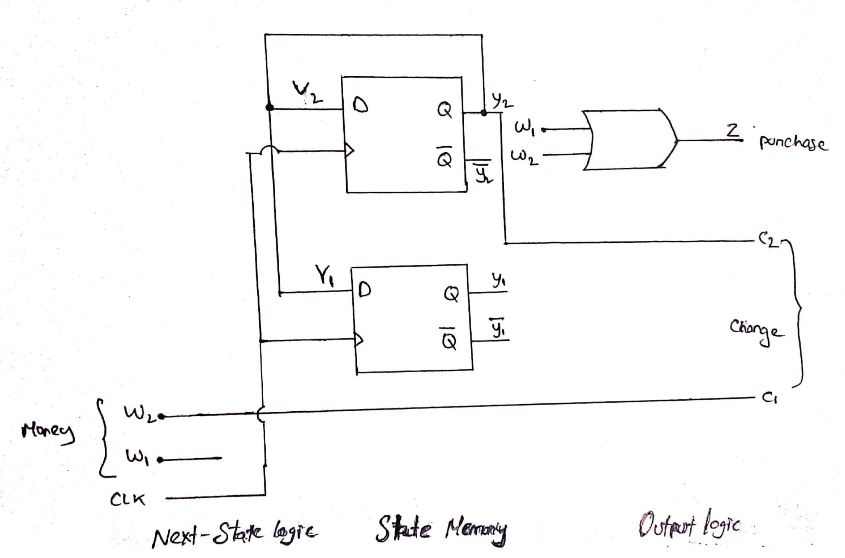
Circuit for 5tk price point

Slide 11
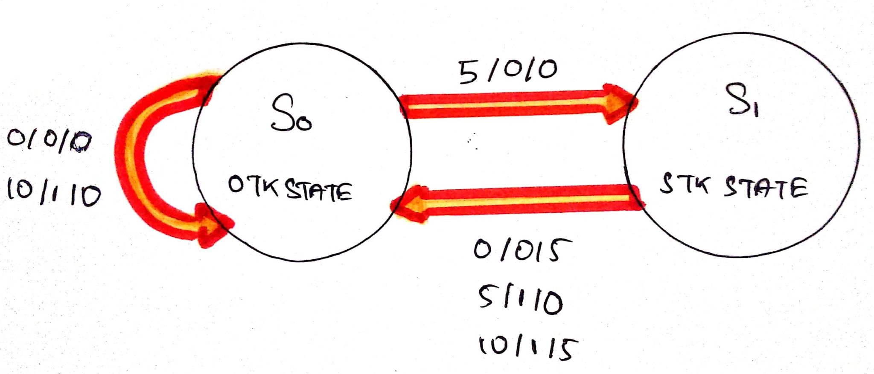
State Flow Diagram for 10tk price point

Slide 12
Methodology for for 10TK PRICE POINT
State Assigned Table:
Present state (y2y1) | Next State (Y2Y1) (w2w1) | Output
Z (w2w1) | C2C1 (w2w1)
 | 00 | 01 | 10 | 11 | 00 | 01 | 10 | 11 | 00 | 01 | 10 | 11
00 | 00 | 01 | 00 | x | 0 | 0 | 1 | x | 00 | 00 | 00 | x
01 | 00 | 00 | 00 | x | 0 | 1 | 1 | x | 01 | 00 | 01 | x
10 | x | x | x | x | x | x | x | x | x | x | x | x
11 | x | x | x | x | x | x | x | x | x | x | x | x

Slide 13
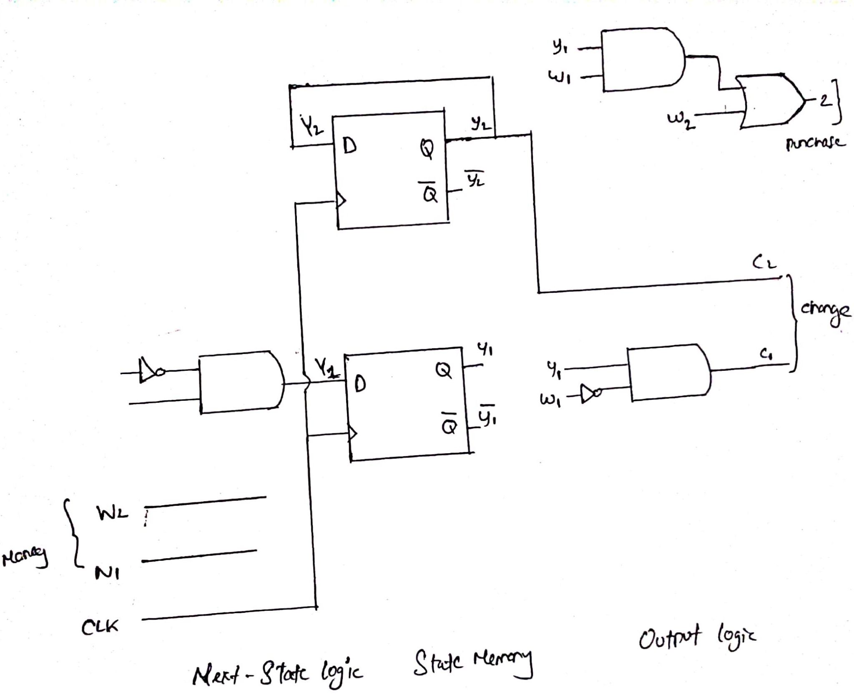
Circuit for 10tk price point

Slide 14
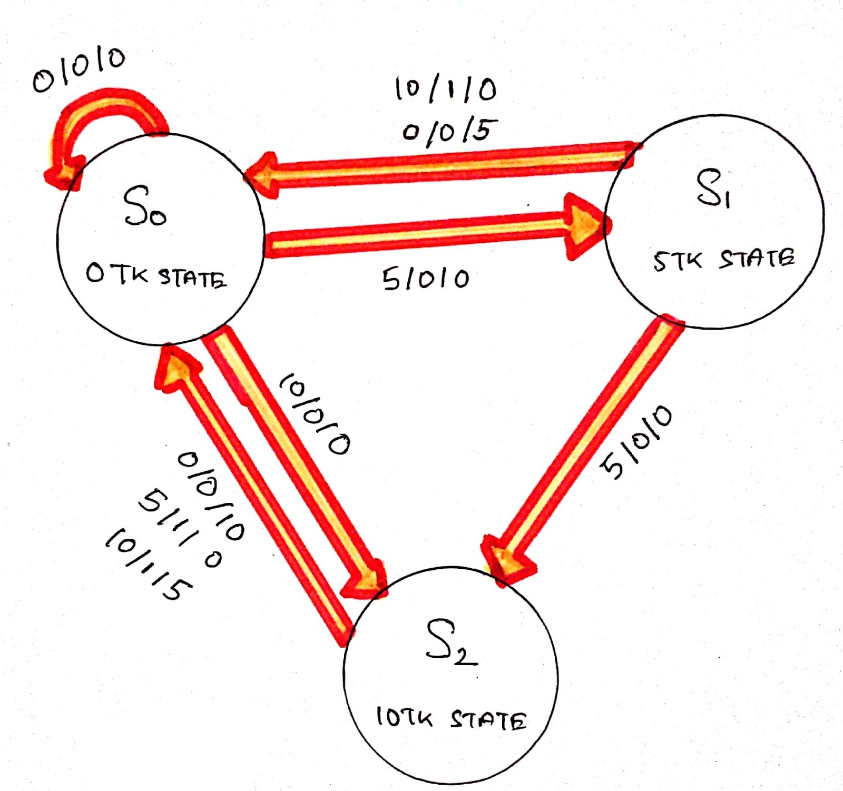
State Flow Diagram for 15tk price point

Slide 15
Methodology for for 15TK PRICE POINT
State Table:
Present State | Next State (Y2Y1) | Output
Z (w2w1) | C2C1 (w2w1)
 | 00 | 01 | 10 | 11 | 00 | 01 | 10 | 11 | 00 | 01 | 10 | 11
S0 | S0 | S1 | S2 | X | 0 | 0 | 0 | X | 00 | 00 | 00 | X
S1 | S0 | S2 | S0 | X | 0 | 0 | 1 | X | 01 | 00 | 00 | X
S2 | S0 | S0 | S0 | X | 0 | 1 | 1 | X | 10 | 00 | 01 | X

Slide 16
State Assigned Table:
Present state (y2y1) | Next State (Y2Y1) (w2w1) | Output
Z (w2w1) | C2C1 (w2w1)
 | 00 | 01 | 10 | 11 | 00 | 01 | 10 | 11 | 00 | 01 | 10 | 11
00 | 00 | 01 | 10 | x | 0 | 0 | 0 | x | 00 | 00 | 00 | x
01 | 00 | 10 | 00 | x | 0 | 0 | 1 | x | 01 | 00 | 00 | x
10 | 00 | 00 | 00 | x | 0 | 1 | 1 | x | 10 | 00 | 01 | x
11 | x | x | x | x | x | x | x | x | x | x | x | x

Slide 17
15 TK K-maps
For Y2: Y2=y2’y1’w2+y1w1 For Y1: Y1=y2’y1’w1
w2w1 y2y1 | 00 | 01 | 11 | 10
00 | 0 | 0 | x | 1
01 | 0 | 1 | x | 0
11 | x | x | x | x
10 | 0 | 0 | x | 0
w2w1 y2y1 | 00 | 01 | 11 | 10
00 | 0 | 1 | x | 0
01 | 0 | 0 | x | 0
11 | x | x | x | x
10 | 0 | 0 | x | 0

Slide 18
15 TK K-maps
For Z: Z=y1w1+y2w1+y2w2 For C2: C2=y2w2’w1’
w2w1 y2y1 | 00 | 01 | 11 | 10
00 | 0 | 0 | x | 0
01 | 0 | 0 | x | 1
11 | x | x | x | x
10 | 0 | 1 | x | 1
w2w1 y2y1 | 00 | 01 | 11 | 10
00 | 0 | 0 | x | 0
01 | 0 | 0 | x | 0
11 | x | x | x | x
10 | 1 | 0 | x | 0

Slide 19
15 TK K-maps
For C1: C1=y1w2’w1’+y2w2
w2w1 y2y1 | 00 | 01 | 11 | 10
00 | 0 | 0 | x | 0
01 | 1 | 0 | x | 0
11 | x | x | x | x
10 | 0 | 0 | x | 1

Slide 20
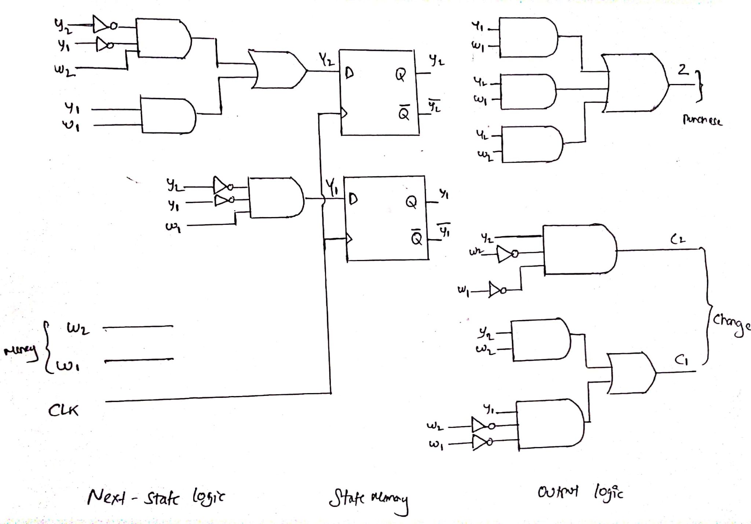
Circuit for 15tk price point

Slide 21
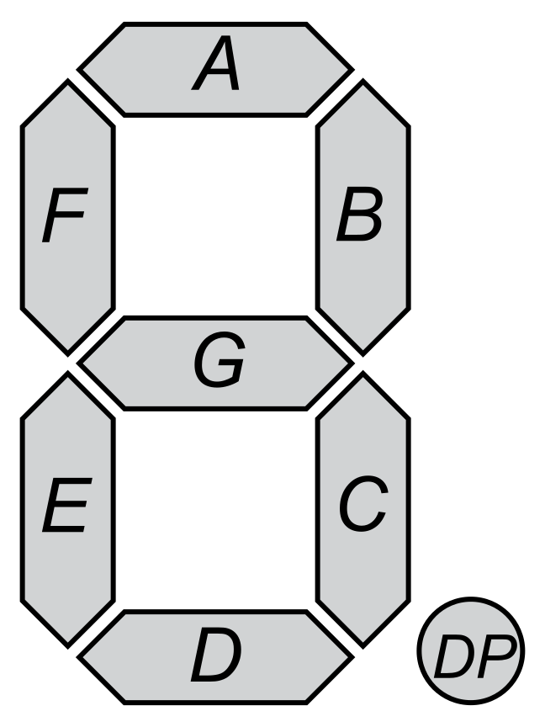
Additional Features outside of the main circuit block:
Displaying the money being inputted and the change being given:
00 is 0 taka, 01 is 5 taka and 10 is 10 taka in our 7 segment
Display. Below we showed the logic using truth table and the eventual
Circuit disconnected from the main block.

Slide 22
MSB (I2) LSB(I1)
A | I2’
B | 1
C | 1
D | I2’
E | I2’
F | I2’
G | 0
A | 1
B | I1’
C | 1
D | 1
E | I1’
F | 1
G | I1

Slide 23
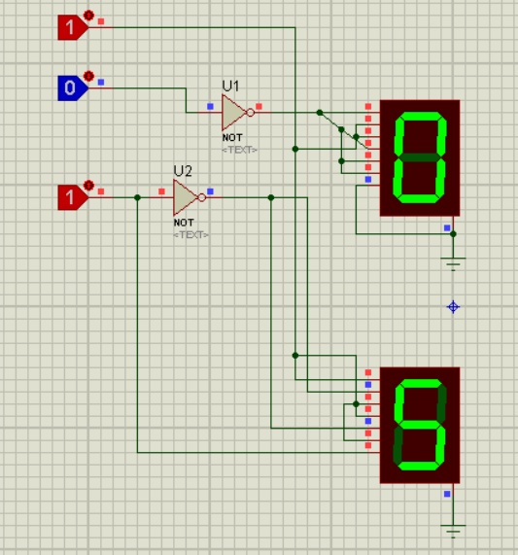
On the left we have the circuit design To represent the money in and changes owed using a 7 segment display.
00 is 0 Tk
01 is 5 Tk
10 is 10 Tk

Slide 24
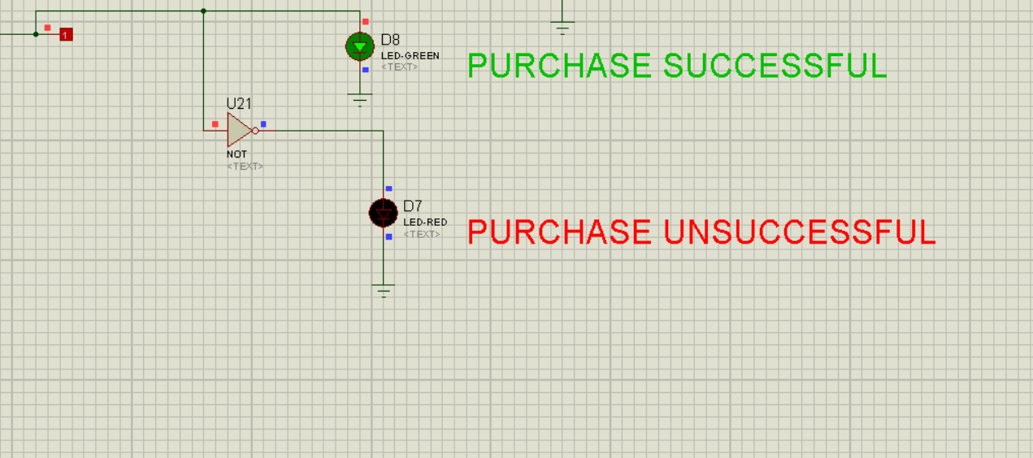
Show using LEDS whether purchase has been successful or unsuccessful.

Slide 25
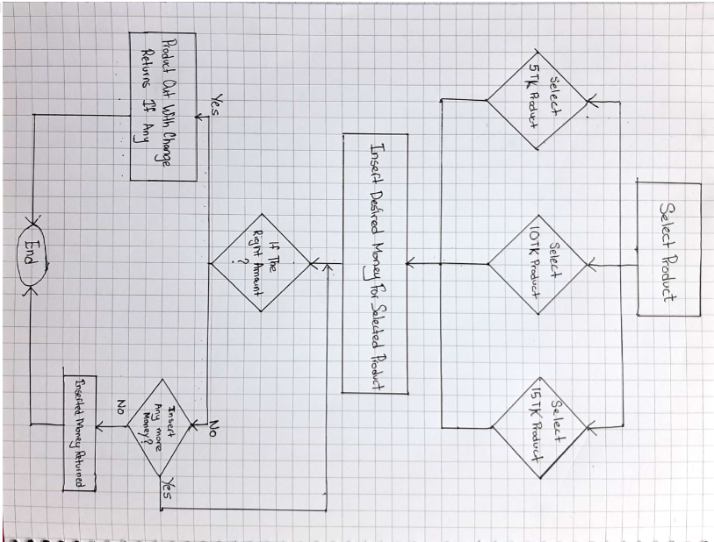
System Design Flow

Slide 26
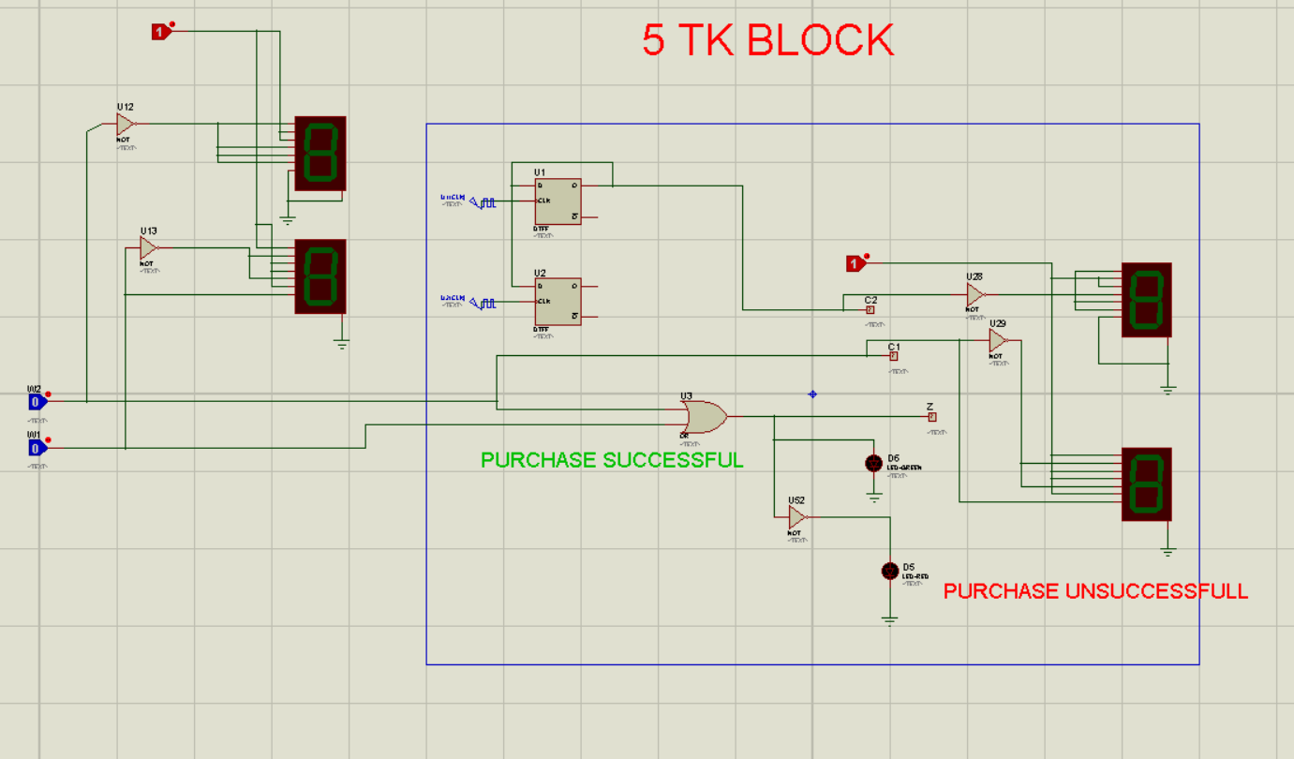
Analysis/Results/Code/Graph/Simulation
5TK BLOCK:

Slide 27
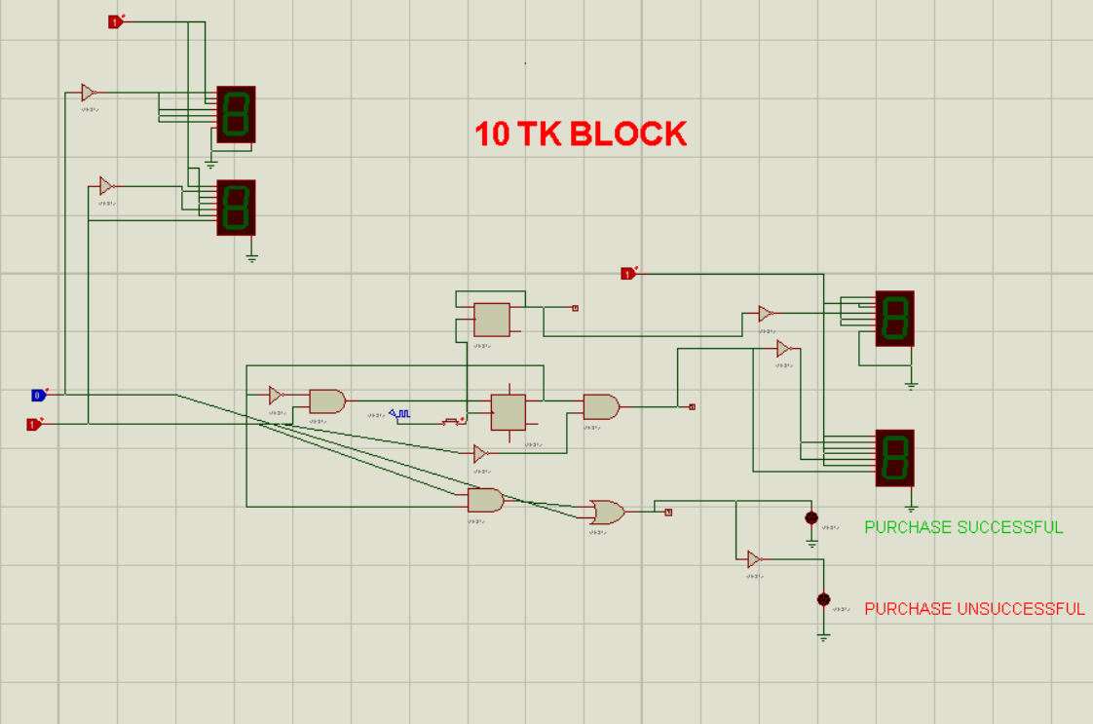
10 TK BLOCK:

Slide 28
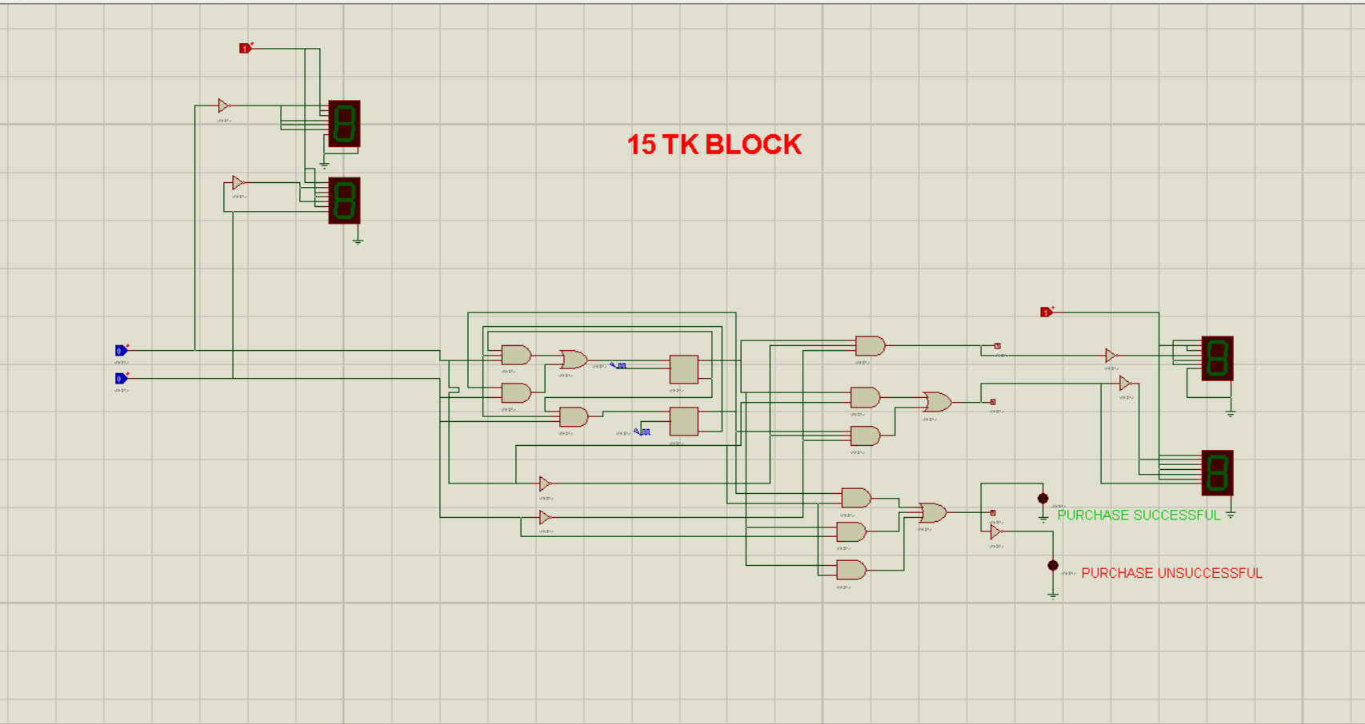
15TK Block:

Slide 29
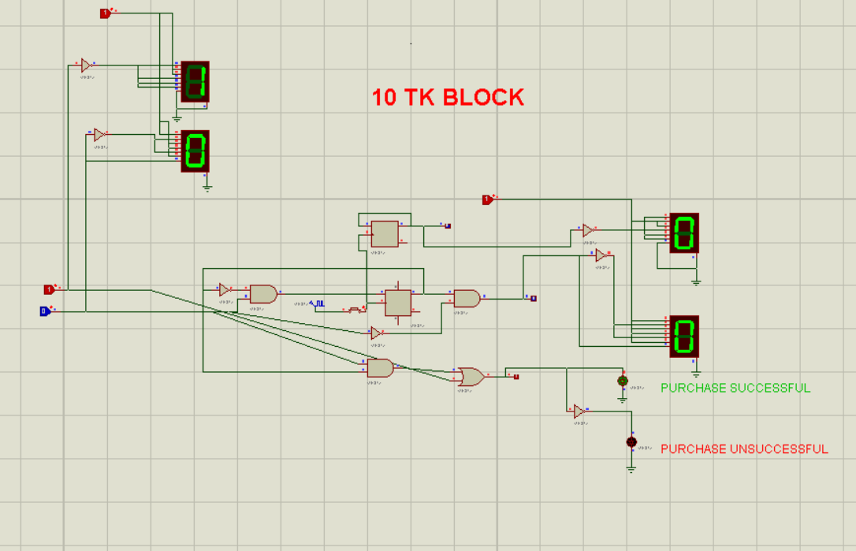
Showing that the product is being dispensed and no change is being given if exact money is inserted:
10 taka money is being inserted
And we are receiving 0 taka
change.Whilst the product
Is being successfully vended as
shown with green led being lit.

Slide 30
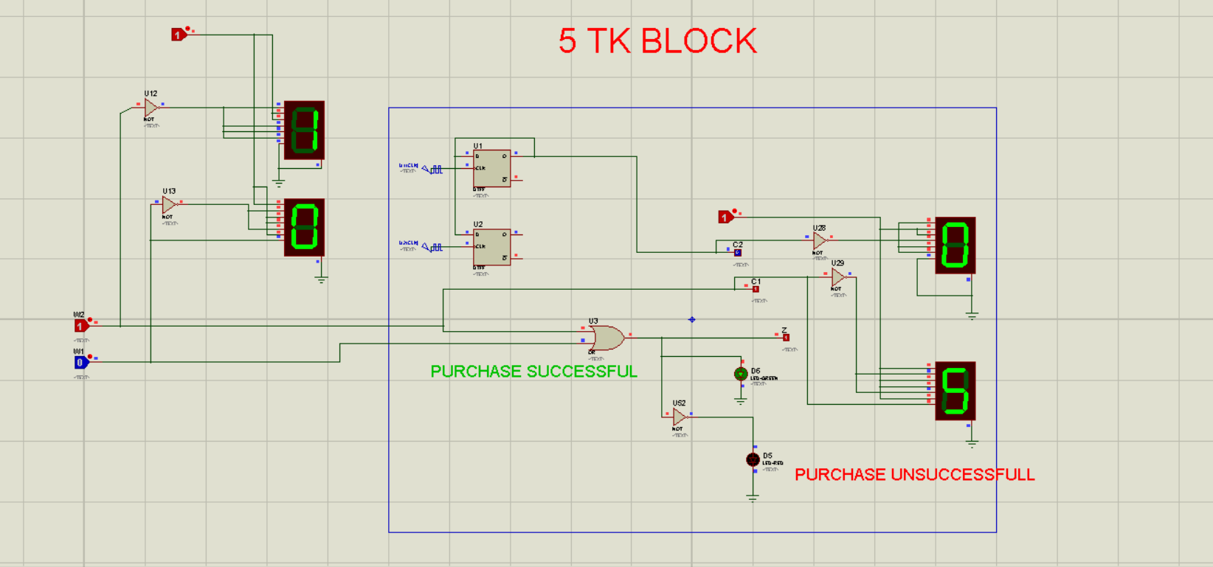
Showing that product is being dispensed and appropriate change is being given if extra money is inserted
10 tk is being inserted
and 5 tk product is being
dispensed whilst 5 tk
change is being
given back as shown

Slide 31
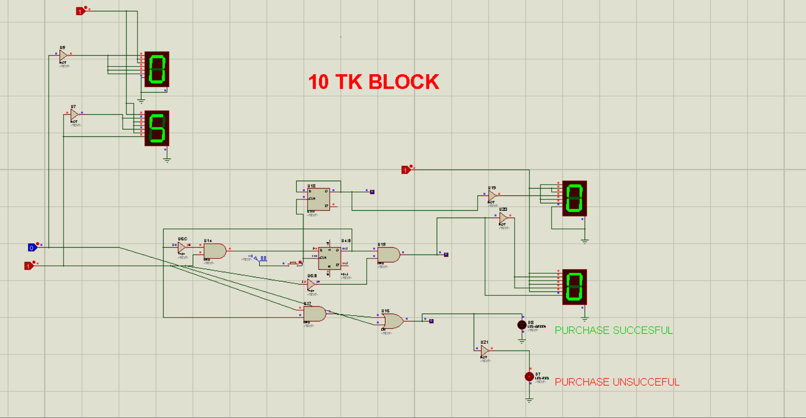
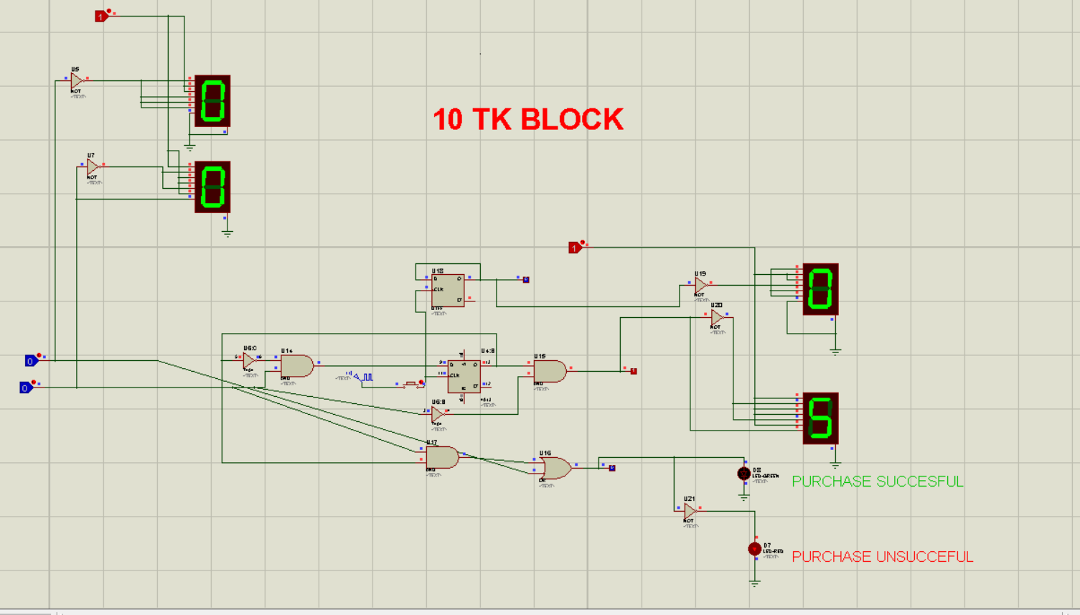
Show that if money is inserted but not the appropriate amount the money is given back to the owner as change

Slide 32
We inserted 5Tk but the product is priced at 10Tk.
In the next clock cycle if we inserted more money than product should’ve been dispensed but we inserted no money so the 5Tk we had originally inserted is returned back to us.

Slide 33
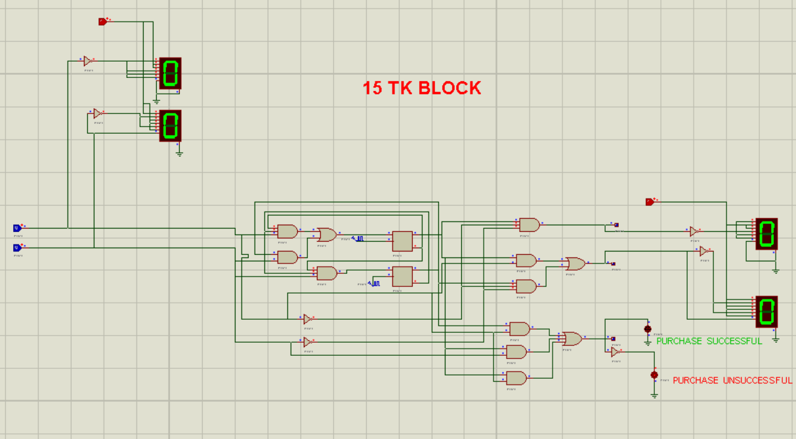
Showing that no product is being dispensed and no change is given if no money is inserted:
As no money is
inserted both the
Money in and change
Display shows 0 TK.
Also LED is red
Showing purchase
In unsuccessful.

Slide 34
Reference
https://www.youtube.com/watch?v=KHanq9mriJI
https://l.facebook.com/l.php?u=https%3A%2F%2Fwww.trendtablet.com%2F9226-the-future-of-vending-machine%2F%3Ffbclid%3DIwAR1vGw-PylTt4RsBZ0lcFcOs1LNreBg9Tt7C81jSvFKAvfTT0L60F5TUrKk&h=AT1VOvSgPa5dXmAHRlJUtmhv_0fSC7GI8mdrlKp_NMSvsoxCGmteLabTxvlZEICfxhOUOxYLyoVCyMMic8i1AkuXam6xxx5RbxbB_OMveB4AOM4AVcF0d3YokdL40GSkoiWTRw
https://www.online-sciences.com/technology/automatic-vending-machines-advantages-and-disadvantages/?fbclid=IwAR2q1srlDrXfyWCqm1RyIvc-jGqqEHByX5tDtomey86GogXnxz6RGMYYrZk
https://www.selecta.co.uk/news/benefits-of-vending-machines/?fbclid=IwAR0b9cfsf-UaR1Dxf8nMxZjzmnkAS48NxCSIEBDkWLuUktu6DQos8nBisqQ

Slide 35

Future work and Conclusion
Vending machines can be used in any deserted place of the world. In remote areas with less shops, if we use vending machines, people can easily purchase necessary products at any time.
Access to food will be easy from any place of the world.
In future we can develop the programmings of vending machines to avoid any kind of fault.Moreover, different apps are being created for finding out the closest vending machine in any particular area.People can also comment on these apps mentioning what products the want or if they have faced any problem while purchasing products.

